Slide 1

NEURAL NETWORK TENSORFLOW

Slide 2
CAN YOU READ THIS?
안녕하십니까
你好

Slide 3
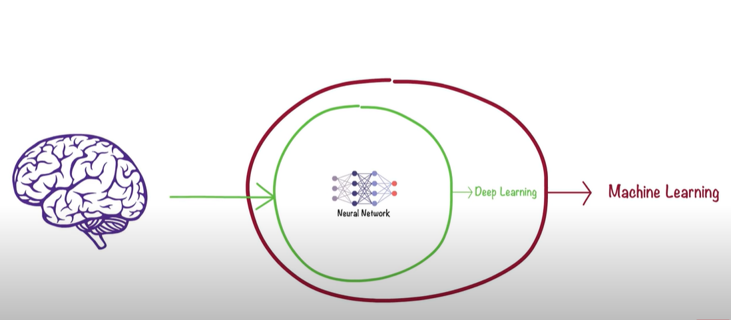
NEURAL NETWORK

Slide 4
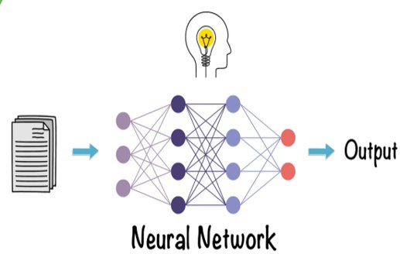

Slide 5
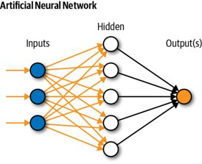
NEURAL NETWORK
NEURON
CHANNELS
WEIGHT
BIAS
ACTIVATION FUNCTION
FORWARD PROPOGATION
BACK PROPOGATION

Slide 6
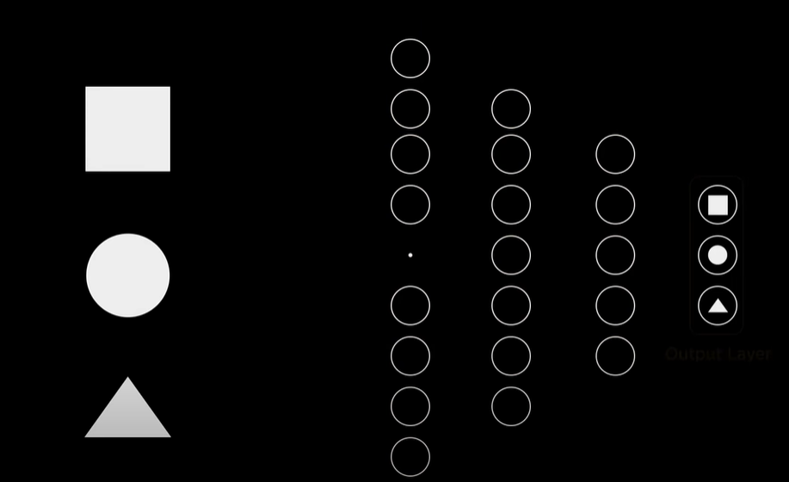
STEP 1

Slide 7
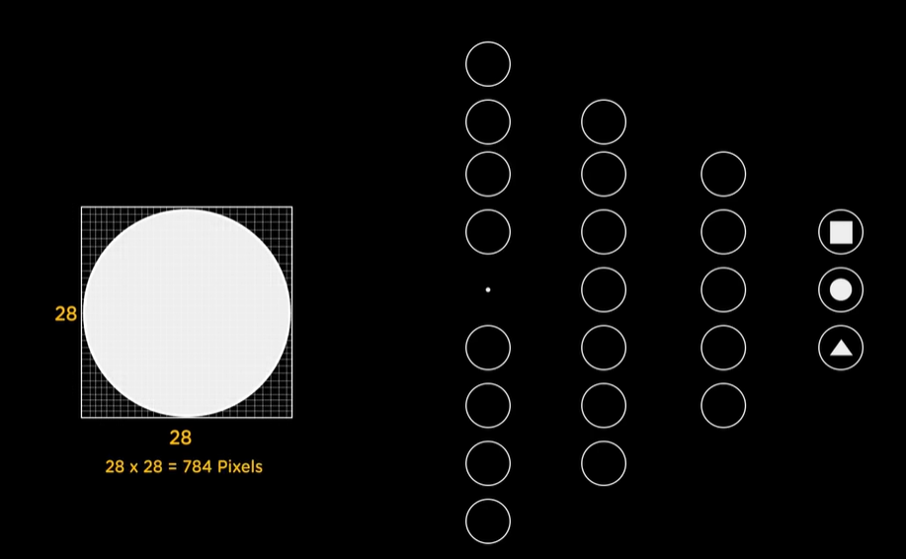
STEP 2

Slide 8
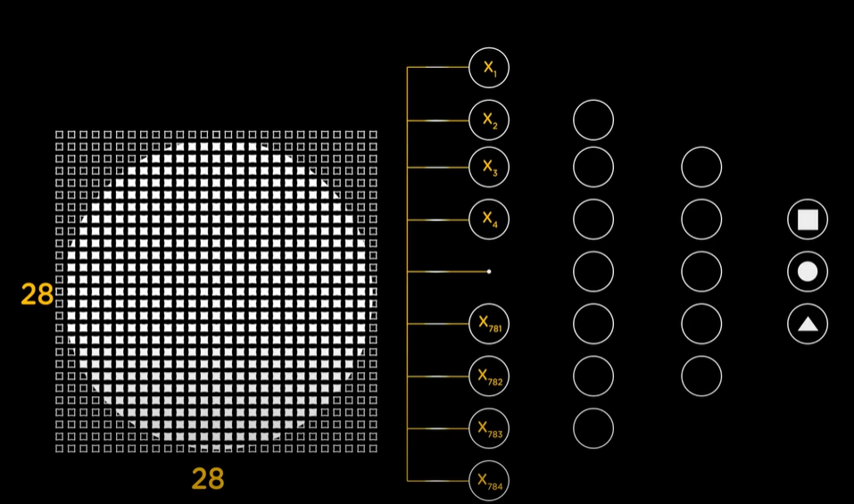
STEP 3

Slide 9
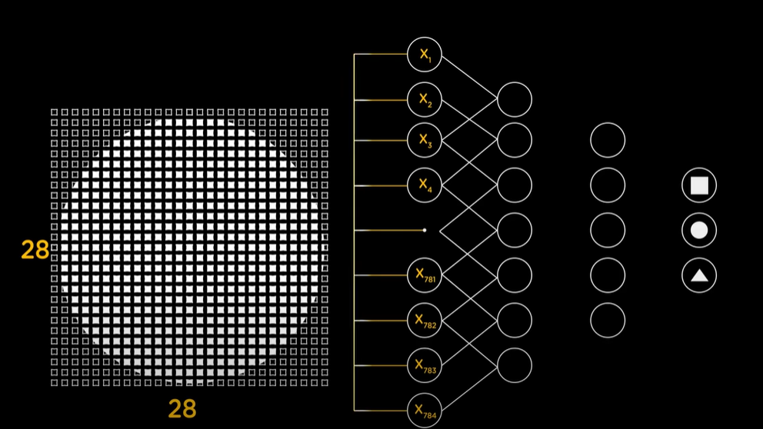
STEP 4

Slide 10
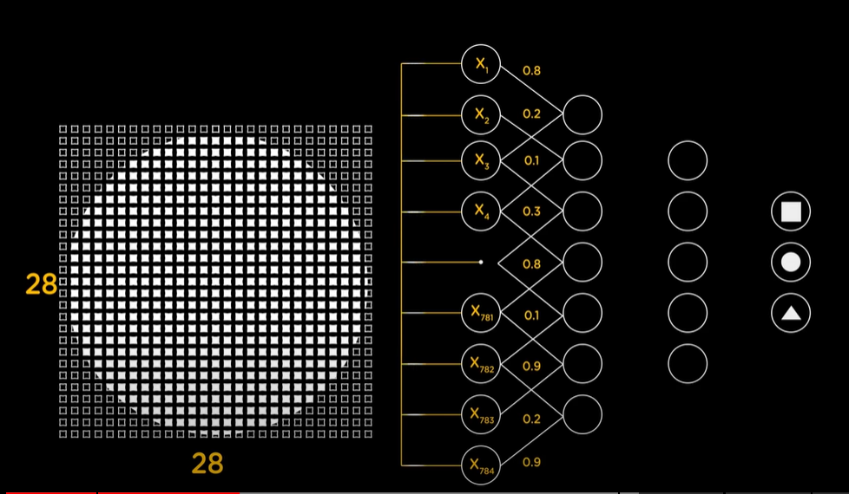
STEP 5

Slide 11
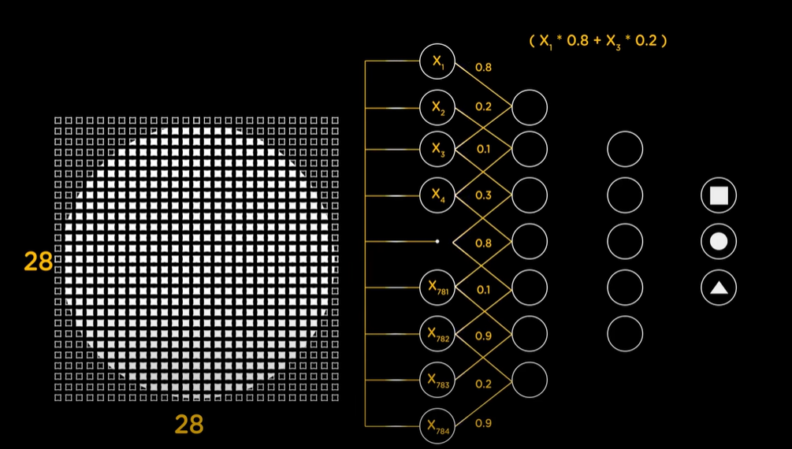
STEP 6

Slide 12
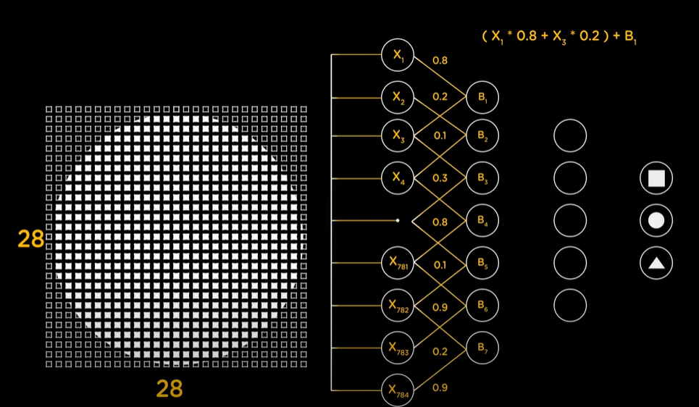
STEP 7

Slide 13
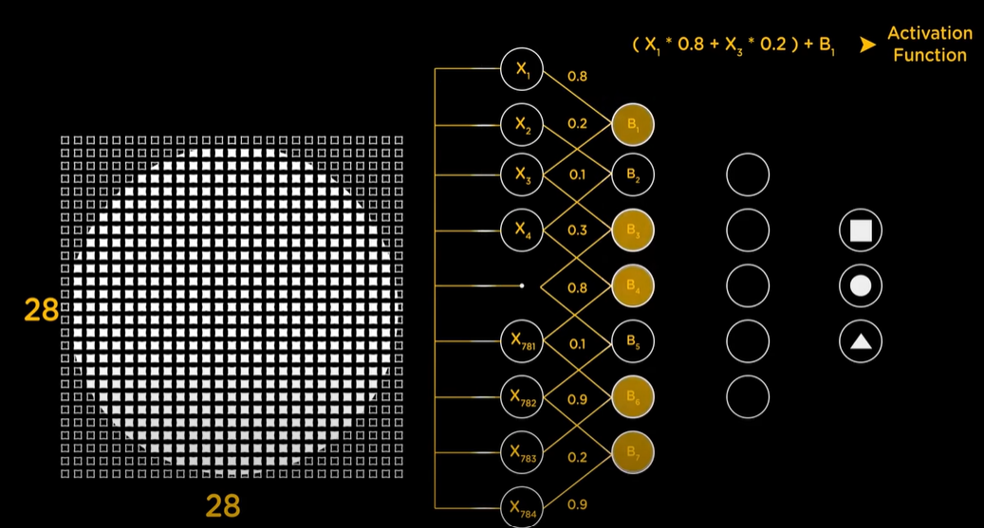
STEP 8

Slide 14
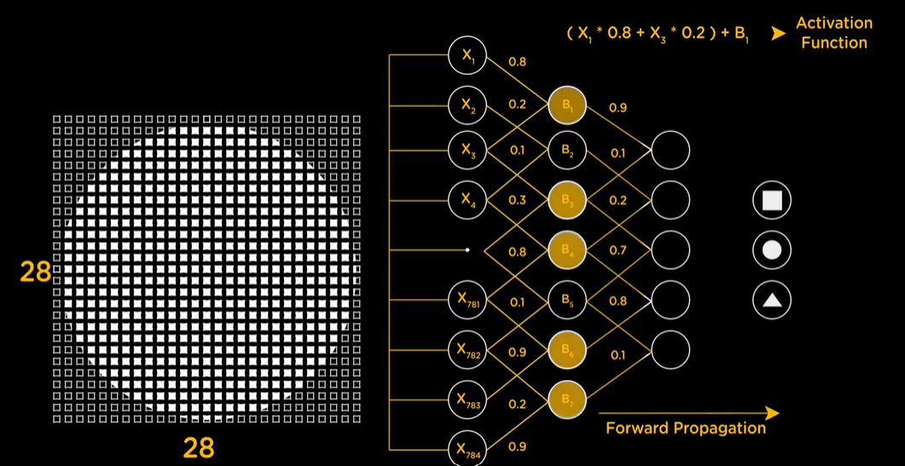
STEP 9

Slide 15
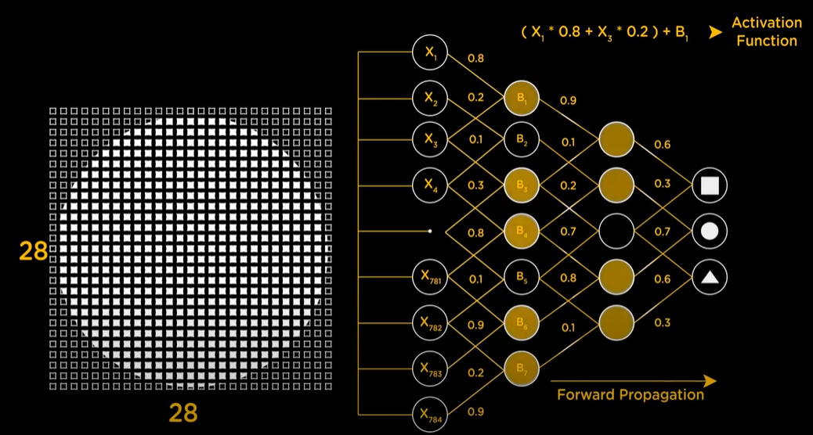
STEP 10

Slide 16
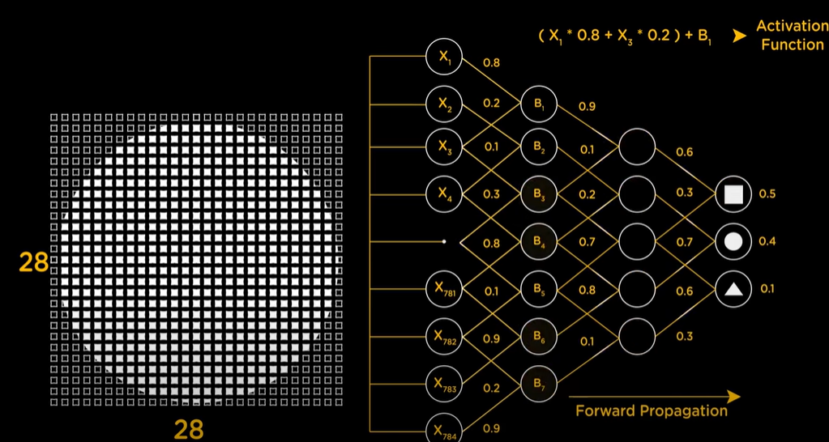
STEP 11

Slide 17
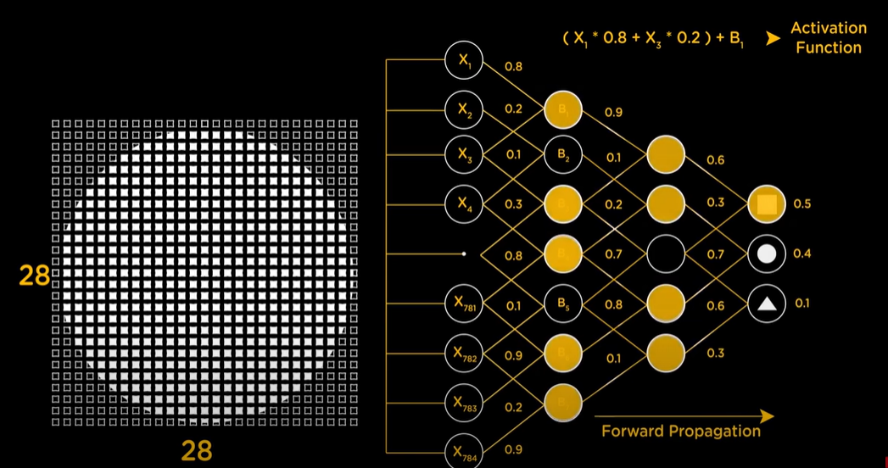
STEP 12

Slide 18
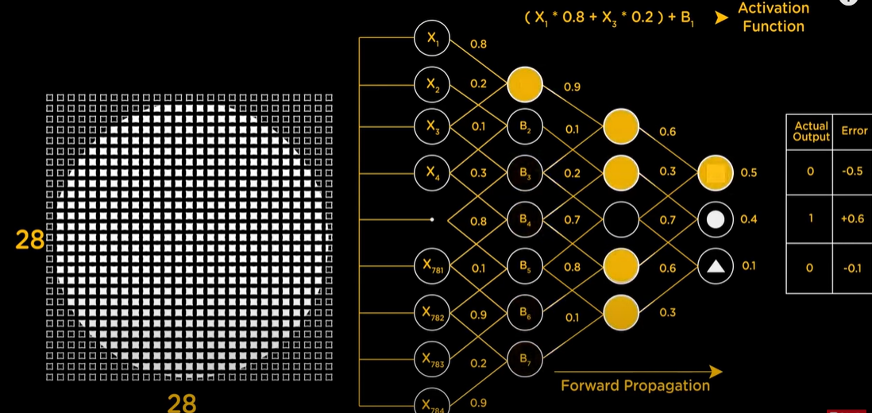
STEP 13

Slide 19
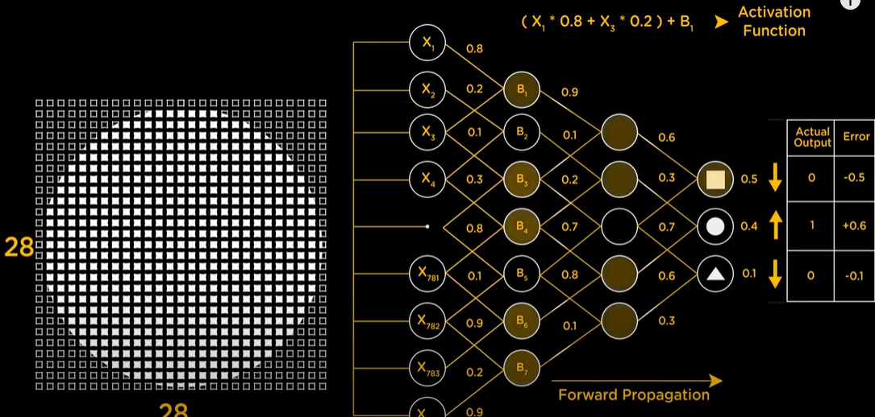
STEP 14

Slide 20
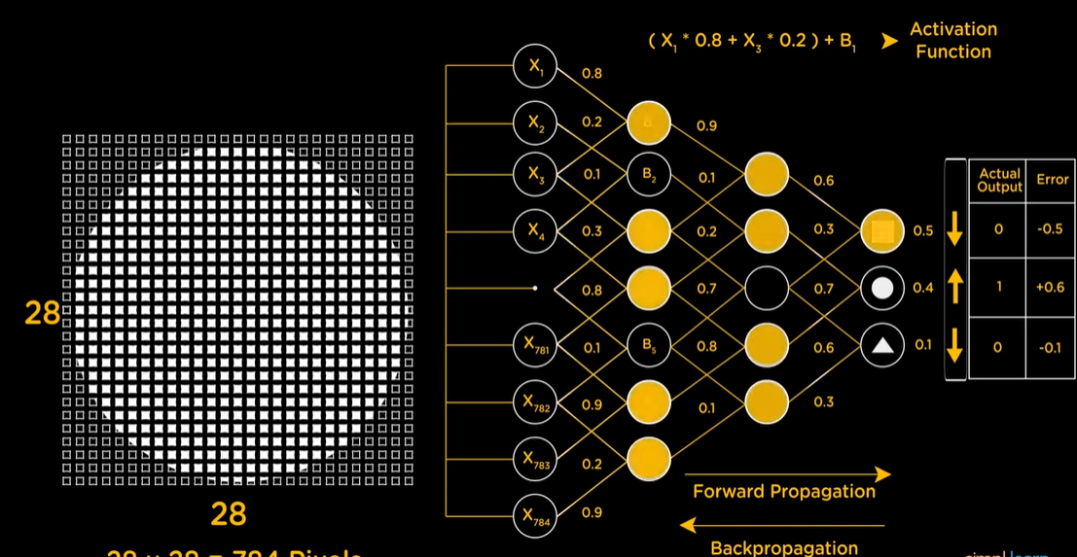
STEP 15

Slide 21

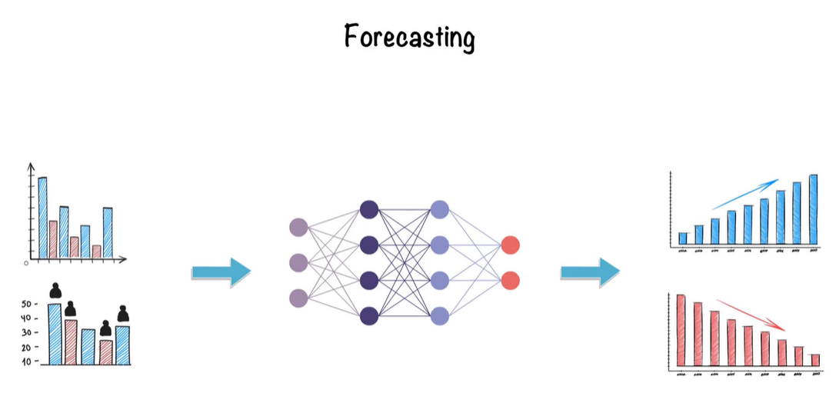
APPLICATION

Slide 22

TENSOR+FLOW=DATA+FLOW

Slide 23
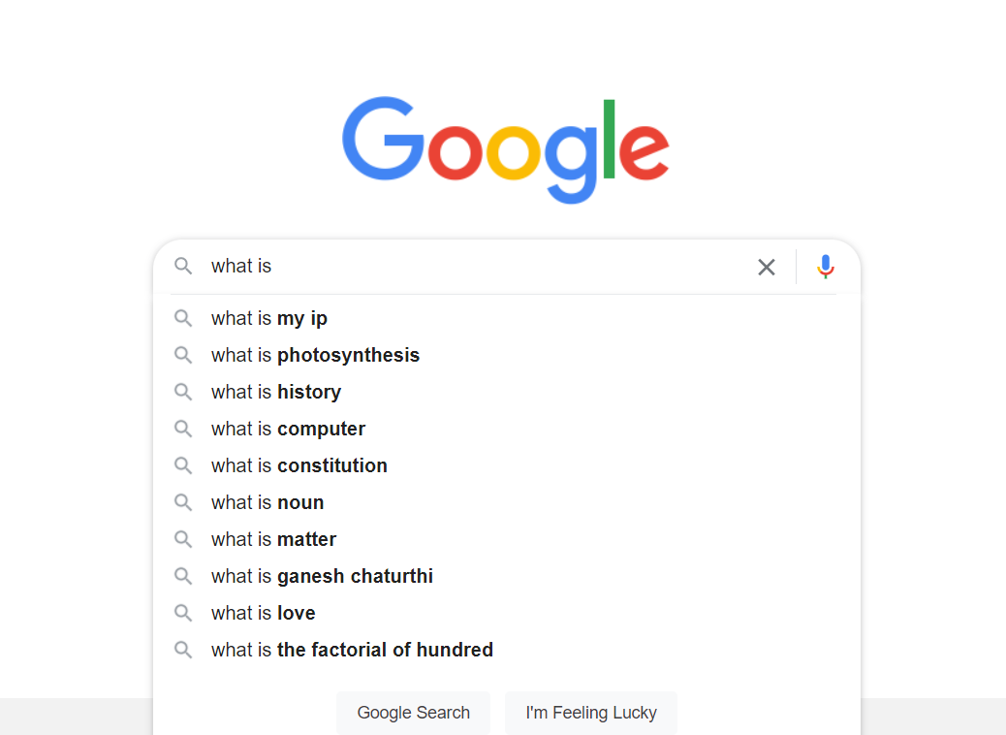
Tensorflow
Open source library
Bulding modules easier and faster

Slide 24
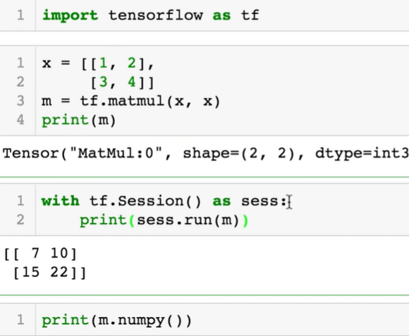
BASIC
EAGER EXECUTION:
Evaluates immediately
Syntax:
tf.executing_eagerly()

Slide 25
BASIC
There are n dimentional array
0-d tensor :scalar-> numbers
1-d tensor: vector ->list of values
2-d tensor: matrix
And so on

Slide 26
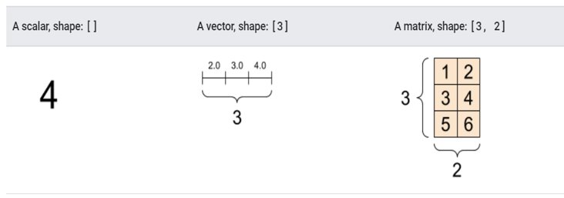

Slide 27
BASIC
Some vocabularies:
Shape
Rank
Axis or Dimension
Size

Slide 28
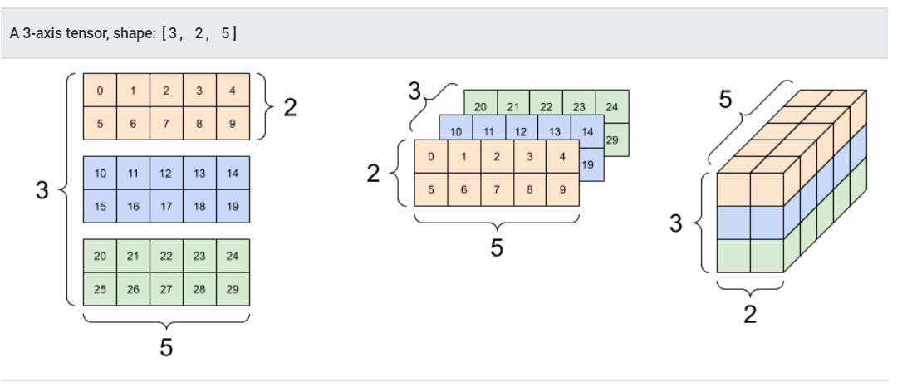
BASIC
Ex:rank_3_tensor = tf.constant([ [[0, 1, 2, 3, 4], [5, 6, 7, 8, 9]], [[10, 11, 12, 13, 14], [15, 16, 17, 18, 19]], [[20, 21, 22, 23, 24], [25, 26, 27, 28, 29]],]) print(rank_3_tensor)
o/p:
tf.Tensor( [[[ 0 1 2 3 4] [ 5 6 7 8 9]] [[10 11 12 13 14] [15 16 17 18 19]] [[20 21 22 23 24] [25 26 27 28 29]]], shape=(3, 2, 5), dtype=int32)

Slide 29
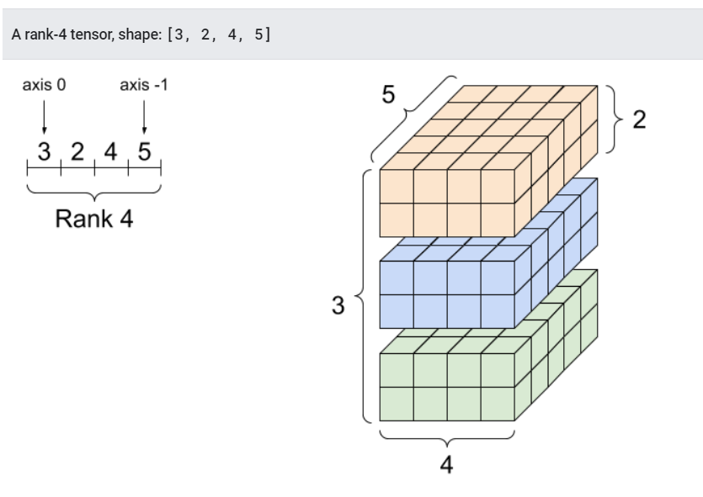

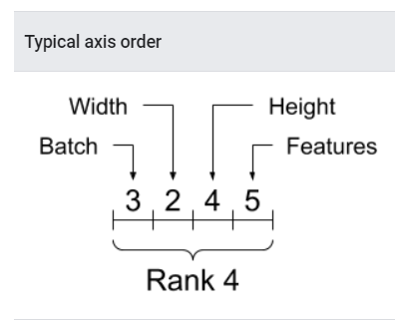
BASIC

Slide 30
CONSTANT AND VARIABLES
CONSTANT:
tf.constant()
VARIABLES:
tf.Variable()
tf.get_variable()

Slide 31
Automatic Differentiation and Gradients
Automatic differentiation
Computing gradient
Gradient tape
Syntax:
tf.GradientTape

Slide 32
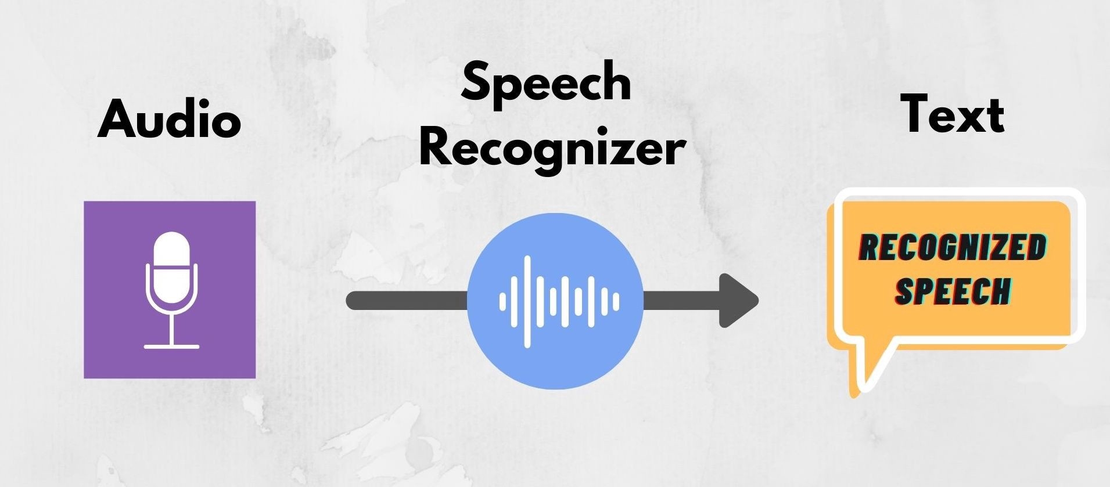
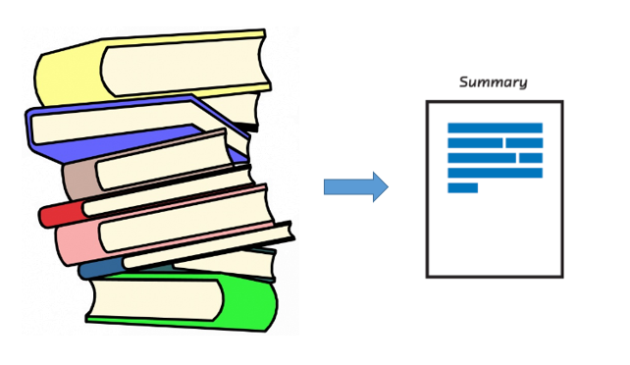
APPLICATION
SPEECH RECOGNINSG SYSTEM
IMAGE OR VIDEO RECOGNITION
TEXT SUMMARIZATION

